Slide 1
CHAPTER-1
INDIA:
SIZE
AND
LOCATION

Slide 2
INDIA:
SIZE AND LOCATION
India is one of the ancient civilizations in the
world. It has achieved multi faceted socioeconomic
progress during the last seven decades.
It has moved forward displaying
remarkable progress in the field of
agriculture, industry, technology and overall
economic development. India has also
contributed significantly.

Slide 3
TOPICS
IN
THIS
CHAPTER
•
India's Location
•
Its Size
•
India and the World
•
Its neighbours

Slide 4
LOCATION
•
Lies entirely in Northern hemisphere between
latitudes 8°4' N and 37°6' N and longitudes 68°7' E and
97°25' E.
•
Divided by Tropic of cancer (23°30' N) in almost two equal
parts.
•
In Southeast, Andaman and Nicobar islands lie in Bay of
Bengal.
•
In Southwest,Lakshadweep islands lie in Arabian Sea.

Slide 5
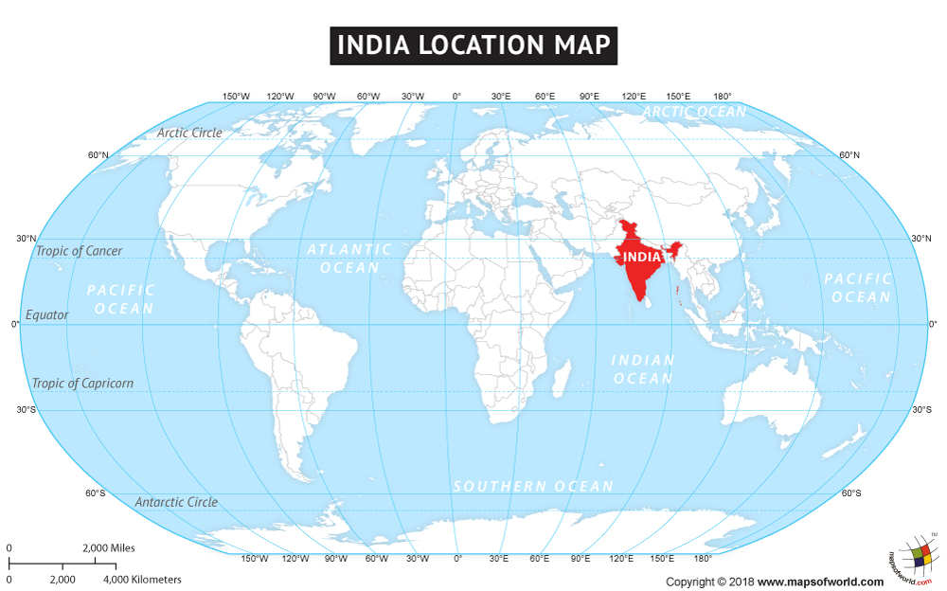

Slide 6
• Total Area of India is 3.28 million square km which is 2.4 percent of the total area of the world.
• It is seventh largest country in the world in terms of landmass.
• It has land boundary about 15,200 km and the total length of the coast line of the mainland
including Andaman and Nicobar and Lakshadweep islands is 7,516.6 km.
• In the northwest, north and north east of India, young folds mountains bounds it.
• South of about 22° north latitude, India narrows and
finally extends towards the Indian Ocean. It also
divides it into two seas, the Arabian Sea on the west
and the Bay of Bengal on its east.

Slide 7
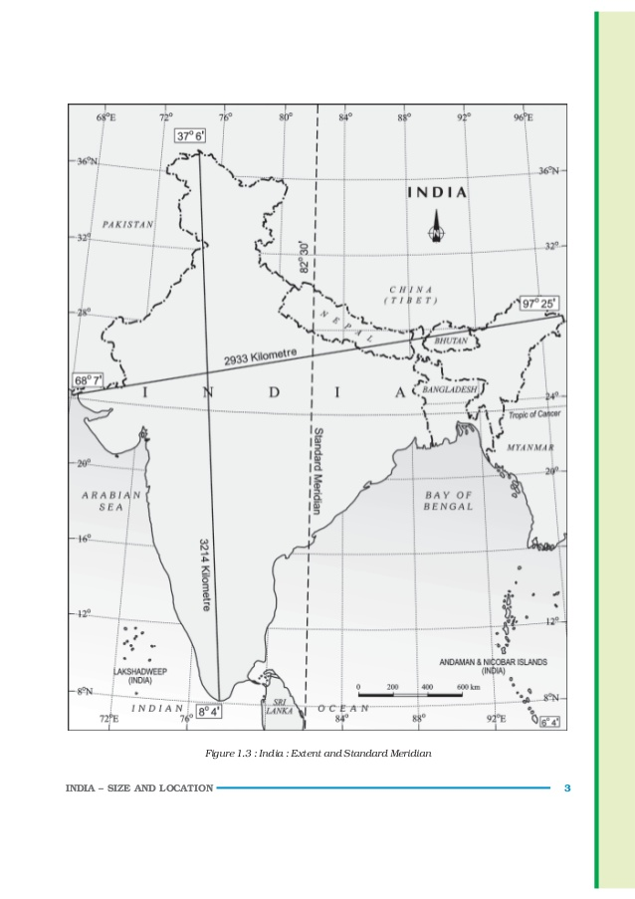

Slide 8
LATITUDINAL
AND
LONGITUDINAL
EXTENT
➢ The latitudinal and longitudinal extent of the mainland
about 30°.
is
➢
India’s
east-west
extent
appears
to
be
smaller
than
the
north-south extent.
The time along the Standard Meridian (82°30' E) passing through Mirzapur in UP is taken as the Indian Standard Time for whole country.
The time gap between Arunachal Pradesh present in the
➢
➢
east and Gujarat present in
latitudinal extent influences as one moves from south to
the west is about 2 hours. The
the duration of day and night, north.

Slide 9
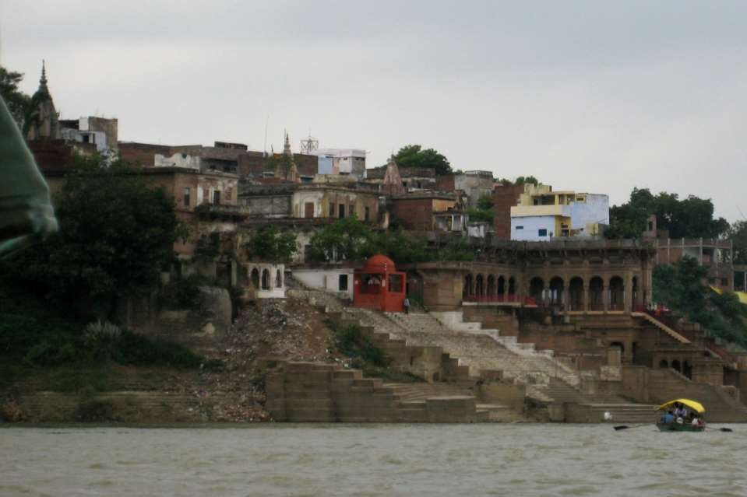
MIRZAPUR
AS THE STANDARD TIME

Slide 10
INDIA AND
THE WORLD
➢ India is located in the
and the West Asia.
centre of the World between
East
➢
The routes across the
countries of Europe in
Indian ocean which connect the
the West and the countries of East
Asia provide a strategic central location to India.
➢
The Deccan Peninsula
helps India to establish close
contact with West Asia, Africa and Europe from the western
coast and with Southeast and East Asia from the eastern
coast.
➢
The Ocean which is south of India given name Indian
Ocean as no other country has a long coastline on the
Indian Ocean as India has.

Slide 11








20
18
,-..., ¹⁶
] 14
•
O" 12
.s 10
^{r}vº 8
~ 6
4
2
0
17.09
•
(/)
9.98
8.51 _{7.69}
Country
9.62
........,
3.28
Ru
Russia
Canada
USA
China
Brazil
Australia
India
LARGEST COUNTRIES OF THE WORLD

Slide 12
➢
The land routes of India are much older than sea route.
Various passes across mountains in the north have provided passages to the ancient travellers as ocean limited such interaction for a long time.
➢
The land routes helped India in the exchange of ideas and
commodities since ancient times.
➢
India have propagated the ideas of the Upanishads and the
Ramayana, the stories of Panchtantra, the Indian numerals and the decimal system as well as given spices, muslin and other merchandise to different countries.
➢
Also, the influence of Greek sculpture, and the architectural
styles of dome and minarets from West Asia can be seen in different parts of India.

Slide 13
ITS
NEIGHBOURS
➢ India is comprised of 29 states and 7 union
territories and shares its land boundary with
➢ →
→
→
→
Northwest: Pakistan and Afghanistan
North: China, Nepal, Bhutan East: Myanmar and Bangladesh South: Sri Lanka and Maldives

Slide 14
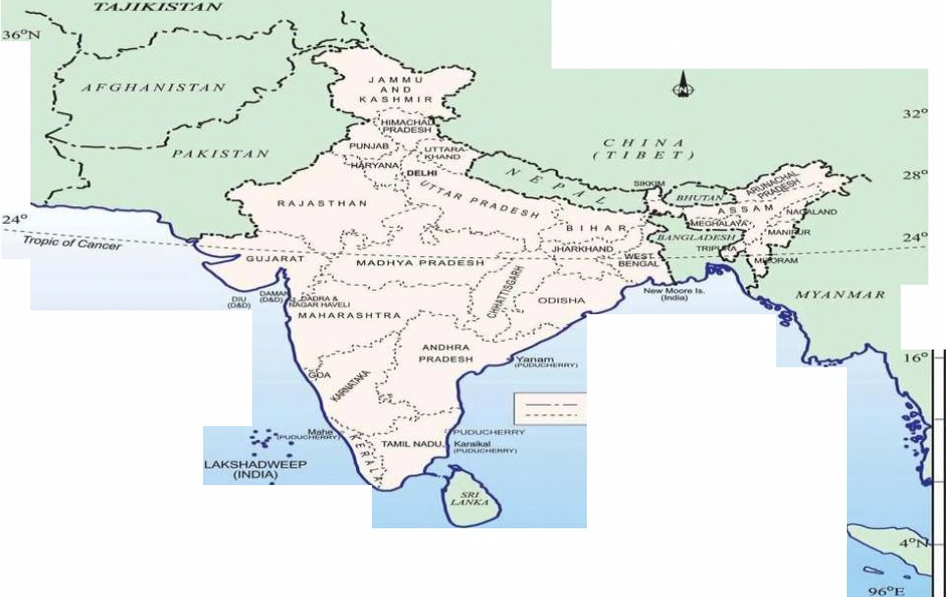
68° 80° 92° 96° I00°E
I
INDIA
ADJACENT COUNTRIES _{36°N}
32°
28
20°
20°
ARABIAN RAY OF
S e A BENOAL
_{lntamatlonal Bounda,y} f
Sto10 eoundoty
•
_{go} ANDAMAN& NICOBAR ISLANDS
(INDIA) •
·,.;
_{4"N} a\
MALDIVES • (}
ago- 0 400 800 km
o.,.
80° as= 92°
.
INDIA AND ADJACENT COUNTRIES

Slide 15
➢ Sri Lanka is separated from India by a
narrow channel of sea formed by the Palk
Strait and the Gulf of Mannar
➢ Maldives Islands are situated
the Lakshadweep Islands.
to the south
of
➢ A peninsula is a piece of land that is
bordered by water on three sides but connected to mainland on one side.

Slide 16
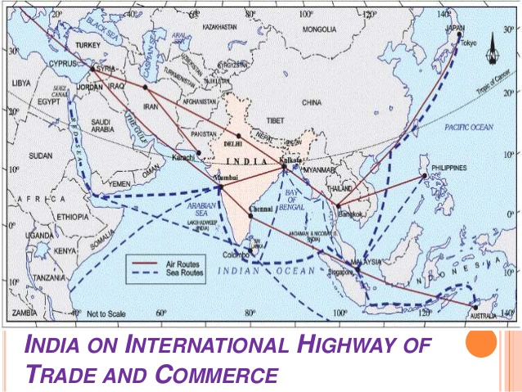

Slide 17
DO YOU
KNOW
FROM
CHAPTER
➢ The southernmost point of the Indian Union ‘Indira Point’ got
submerged under the sea water in 2004 during the Tsunami.
➢ Since the opening of the Suez Canal in 1869, India’s distance
from Europe has been reduced by 7,000 km.
➢ Before 1947, there were two types of states in India – the
provinces and the Princely states.
→ Provinces were ruled directly by British officials who were
appointed by the Viceroy.
→ Princely states were ruled by local, hereditary rulers, who
acknowledged sovereignity in return for local autonomy

Slide 18
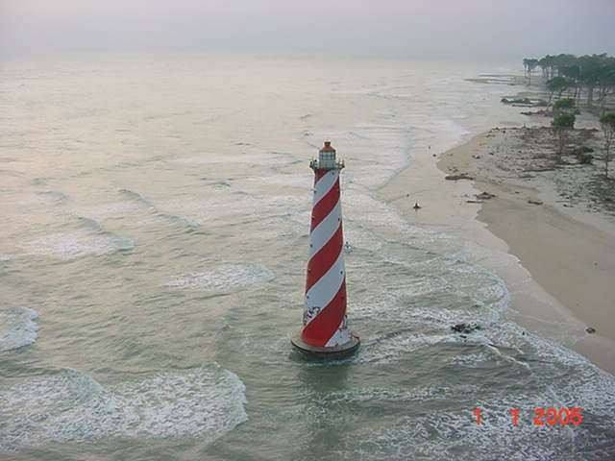
THE SOUTHERNMOST POINT OF INDIA
INDIRA POINT
‘

Slide 19
SUMMARY
➢
India is known for its rich commercial and cultural heritage and home to some of the oldest civilizations in the world, like the Indus Valley Civilization.
➢
India spreads across both the Eastern and the Northern Hemispheres. India’s latitudinal stretch is between 8.4 degrees N and 37.6 degrees N, and the longitudinal stretch is between
68.7 degrees E and 97.25 degrees E.
➢
The Tropic of Cancer at 23.30 degrees North latitude cuts across the country, dividing it almost into two equal halves. The country has the Andaman and Nicobar Islands in the south-east and the Lakshadweep Islands in the southwest.
➢
The total area of the Indian land mass is 3.28 million square kilometres i.e. nearly 2.4% of the total land area of the world. India is the seventh largest country in the world.

Slide 20
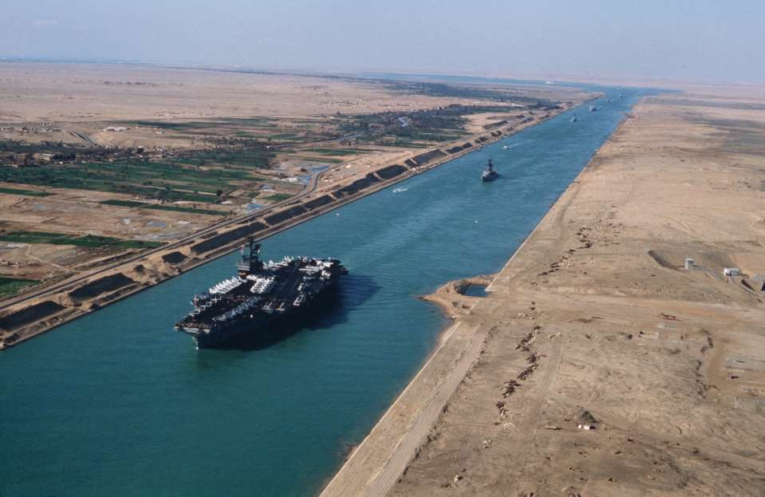
SUEZ
CANAL

Slide 21
➢
India is bordered by the young fold mountains on the north-
western, northern and north-eastern side, the Bay of Bengal in the east, the Arabian Sea in the west and the Indian Ocean in the south
The tapered shape of southern India divides Indian Ocean into the Arabian Sea and Bay of Bengal! India’s total coastline, including the Andaman and Nicobar Islands, and the Lakshadweep Islands measures 7,516.6 kilometres.
India’s east-west stretch and north south stretch each measure approximately 3000 kilometres and causes a time lag of 2 hours between the local times at the eastern and the western ends.
India’s standard time is the time along longitude 82.30 degrees East. This longitude passes through Mirzapur in Uttar Pradesh and is referred to as the Standard Meridian of India.
While India’s longitudinal stretch gives rise to a time lag between the east and the west, its latitudinal stretch influences the duration of days and nights.
➢
➢
➢
➢

Slide 22
Thank you…………..

